Slide 1
Relational Database Query Execution
Software Performance Engineering

Slide 2
The Life of a Query
An SQL query starts as a string
Compilation: gets converted to a parse tree
Query rewrite
Convert from parse tree to logical query plan
Some optimization steps here
Different tree structure
Physical plan generation
Convert logical query plan to physical query plan
Select algorithms for each of the operators
Choose order of operations
Governed largely by disk I/O
“Query optimizer” is a catch-all term for those second two steps

Slide 3
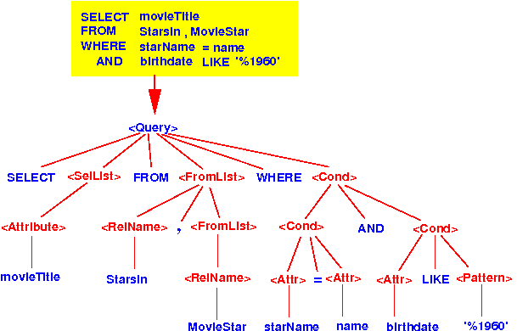
Example Parse Tree
From: http://www.mathcs.emory.edu/~cheung/Courses/554/Syllabus/5-query-opt/FIGS/parseTree01.gif

Slide 4
Physical Plan Operators
Table scan
Iterate over the entire table in physical order
Return them in the order they were physically located
Index scan
Do a lookup on an index
Return the items that match the index
Possibly physically adjacent, possibly not
Sort-scan
Return the tuples needed in sorted order (e.g. ORDER BY, or other query operations)
Can be done in a few ways
Does the index support sorted returns? e.g. use b+trees
Will the results fit in a sort buffer? Place tuples in a sort buffer and sort as a separate operation
Otherwise, sort the results in pieces and place them back on secondary storage and return merge-sorted

Slide 5
Categories of Operations
Tuple-at-a-time, unary operations
Some operations only need to see one tuple at a time
e.g. selection
Only needs a small buffer
But, they still benefit from multiple buffers because physical scans can read a lot at a time
Full-relation, unary operations
The entire table is needed, but only one parameter
e.g. grouping (GROUP BY)
e.g. duplicate-elimination (DISTINCT)
Full-relation, binary operations
e.g. join, union, intersection, cross-products

Slide 6
One-Pass vs. Two-Pass Algorithms
Some algorithms allow for only one pass through the data, others require two iterations
Many of the two-pass algorithms involve sorting first, then using that assumption
So are two-pass algorithms worse than one-pass?
Not necessarily.
Two-pass algorithms can use less memory
If sorting was already required, then using that assumption speeds up other operations anyway – best to choose the right algorithm for the situation

Slide 7
e.g. DISTINCT
Is DISTINCT a slow operation?
SELECT DISTINCT username FROM access_logs
Without any other conditions, yes
Requires an input buffer to conduct a hash-based distinction
Memory usage is dependent upon the distribution of usernames!! (i.e. many names, bigger hash table…)
But! What if we:
Use a B-tree: then we can return lists in sorted order
Have the table be in physically sorted order so that sequential reads are fast
Now we can do a two-pass
Knowing we’ll see usernames in sorted order, we know that any duplicates would be adjacent
Now we can store ONLY the last tuple and compare
Less memory, and faster

Slide 8
e.g. GROUP BY
How can aggregation be computed?
e.g. SELECT username, count(*) FROM access_logs GROUP BY username
One-pass algorithm: hash table in the input buffer, {“admin”=>10}
Note: aggregation operator has a big impact on memory usage
e.g. COUNT, MIN, MAX are small – need one number per group
e.g, AVG is big – need to keep the entire group!
Two-pass algorithm: sort by username
e.g. SELECT student, avg(*) FROM grades GROUP BY student
You know all students named “dustin” are adjacent on disk
Store beginnings and ends of groups to the places on disk and access them when needed

Slide 9
Iterator Pattern
Relational databases will often implement the iterator pattern
Have a LIMIT on the result set explicitly
Or, the result set has an internal limit based on the iterator
This can often complicate the implementation of these algorithms
This often can be exploited for performance reasons:
Instead of sorting an entire table, only try to retrieve the top 10
“Retrieve the top 10” is a different algorithm than sorting!

